Slide 1


Northrop Grumman Mission Systems Innovation Challenge IMAGE RECOGNITION
Title: 99.9%
Logo: 99.9%
Logo: 99.9%
DUGS 108
Utsav Patel
Dipam Patel
Gunjan Khut
Saimouli Katragadda
(Graduate Students of Robotics)
Names: 99.9%
Notes:
*sai

Slide 2
Agenda
Computer Vision vs. Deep Learning
Why Transfer Learning?
Model Selection
Training -- Trial Runs -- Data Augmentation -- Output
Future Work
Notes:
*sai

Slide 3
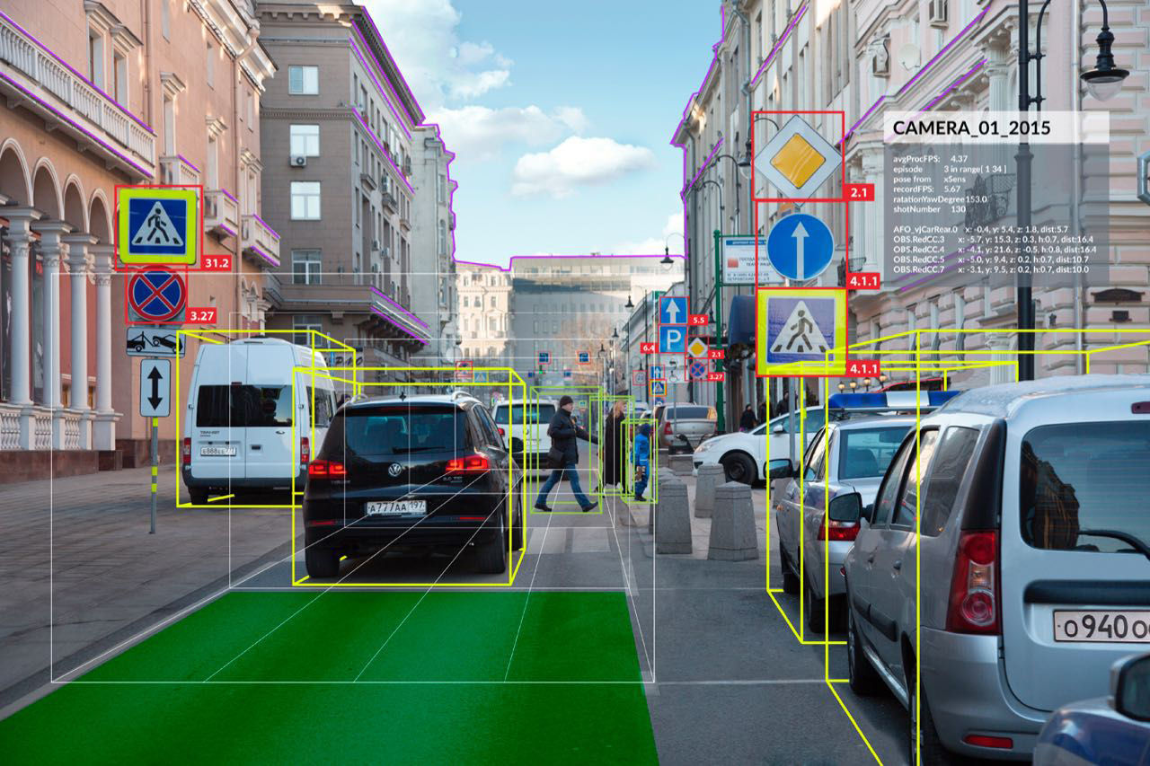
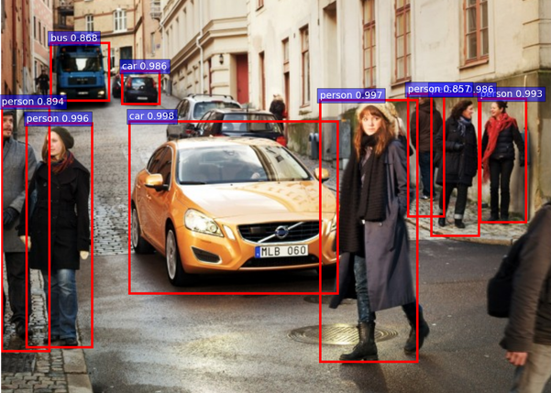
Computer Vision
Deep Learning
Player-1
Player-2
Computer Vision
vs
Deep learning
Source: http://yonah.org/channel/visionhack-computer-vision-russia/
Source: https://bigsnarf.wordpress.com/2016/11/07/faster-r-cnn-pedestrian-and-car-detection/
Notes:
*Sai

Slide 4
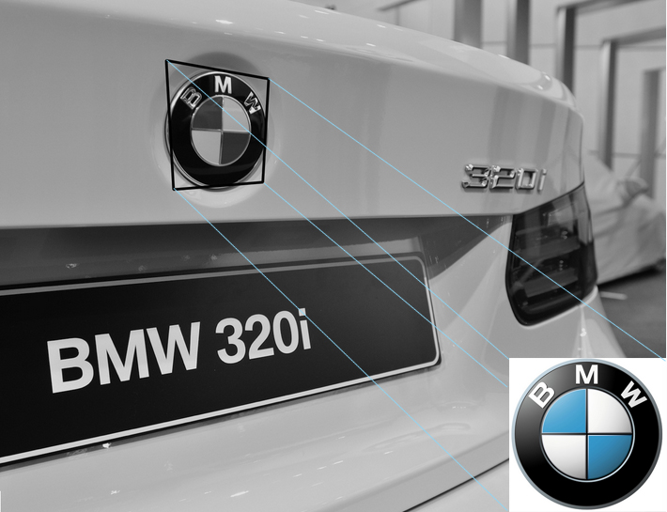

Computer Vision
Deep Learning
https://www.google.com/url?sa=i&source=images&cd=&ved=2ahUKEwjLm8mkn9XeAhVNwlkKHZRlA9sQjxx6BAgBEAI&url=http%3A%2F%2Fpixuate.com%2Ftechnology%2Ftemplate-matching%2F&psig=AOvVaw3SSQJz3SF_PZA0RySahMLX&ust=1542331649115222
Player-1
Player-2
As number of features increases, so does the parameters describing them also increases
Limitation on accuracy and detection
Learns to extract the salient features on its own
Large data input; accuracy not an issue
Notes:
*Sai

Slide 5
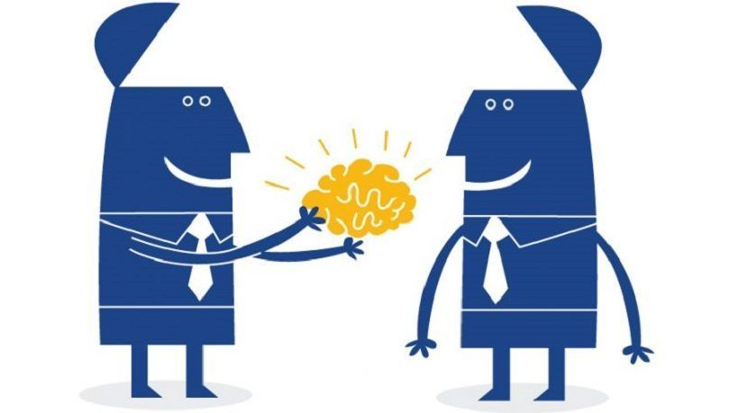
Why Transfer Learning?
Source: https://elearningindustry.com/5-tips-improve-knowledge-transfer-elearning

Slide 6
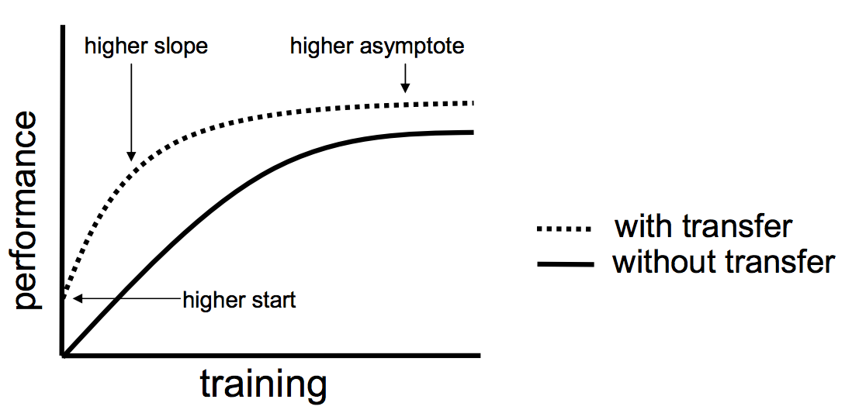
Why Transfer Learning?(contd…)
Used for transferring knowledge of the pretrained network to the current network
The learning process can be much faster, more accurate and needs less training data
Low level features from Task A could be helpful for learning Task B
Source: https://machinelearningmastery.com/transfer-learning-for-deep-learning/
Notes:
Training data from scratch needs lots of data (millions of datasets) and the answer to all calls come with transfer learning

Slide 7
Model Selection
Notes:
*sai

Slide 8
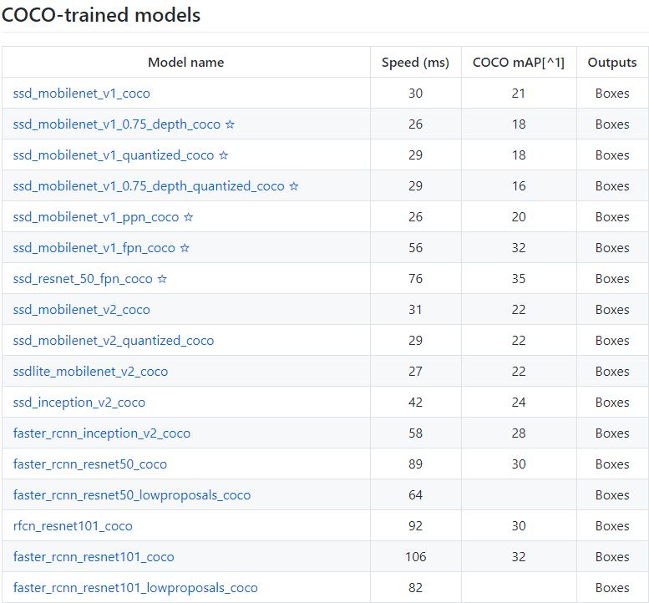
Available Pre Trained Models for Transfer Learning
Following are the pre trained models available and their comparison on the basis of speed and accuracy
https://github.com/tensorflow/models/blob/master/research/object_detection/g3doc/detection_model_zoo.md

Slide 9
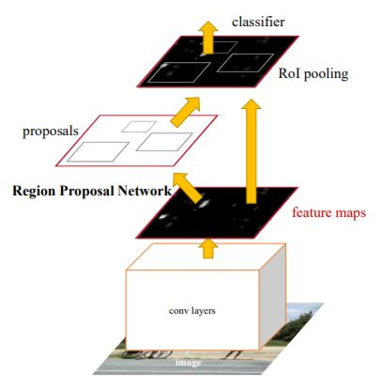
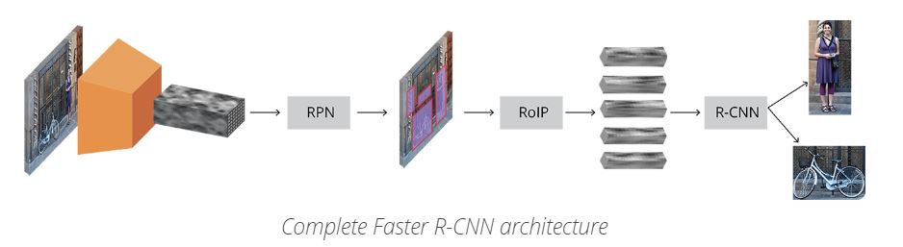
Architecture for Faster RCNN
Continue….
Sources- https://arxiv.org/pdf/1506.01497.pdf and https://tryolabs.com/blog/2018/01/18/faster-r-cnn-down-the-rabbit-hole-of-modern-object-detection/

Slide 10
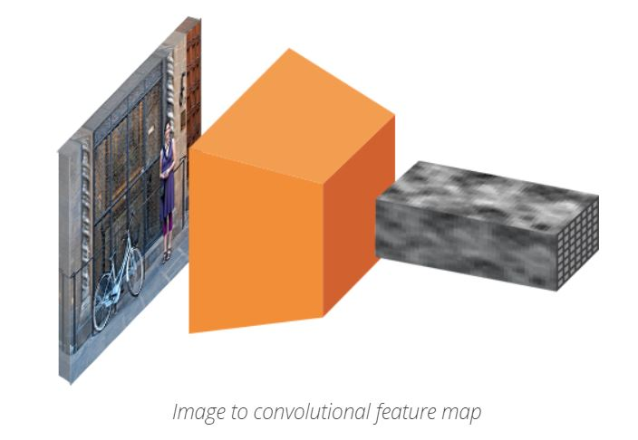
Architecture for Faster RCNN(contd...)
Images are passed through a pre trained CNN until an intermediate level
https://tryolabs.com/blog/2018/01/18/faster-r-cnn-down-the-rabbit-hole-of-modern-object-detection/

Slide 11
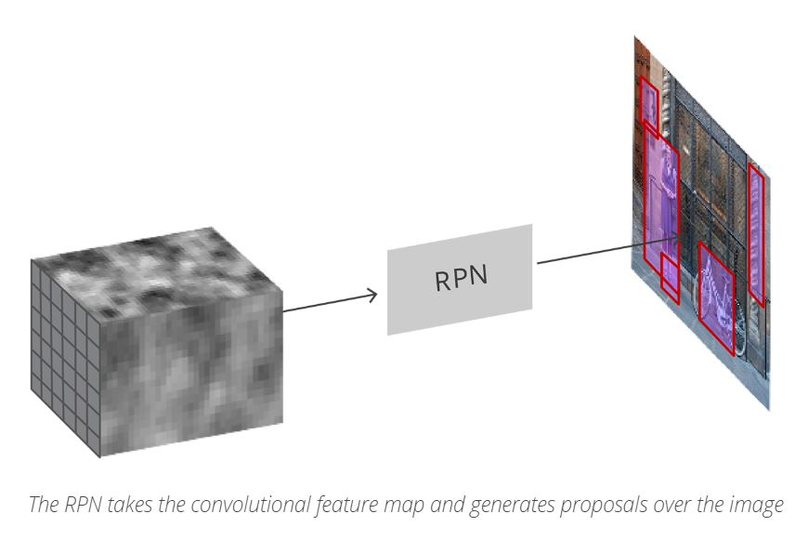
Architecture for Faster RCNN(contd...)
Regional proposal uses the feature map generated in the previous step to find pre defined number of bounding boxes.
https://tryolabs.com/blog/2018/01/18/faster-r-cnn-down-the-rabbit-hole-of-modern-object-detection/

Slide 12
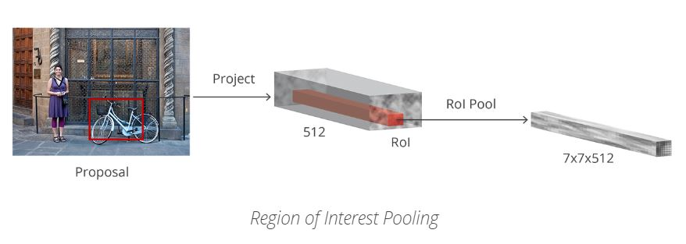
Architecture for Faster RCNN(contd...)
Region of Interest (RoI) Pooling is then applied and those features which would correspond to the relevant objects into a new tensor are extracted
https://tryolabs.com/blog/2018/01/18/faster-r-cnn-down-the-rabbit-hole-of-modern-object-detection/

Slide 13
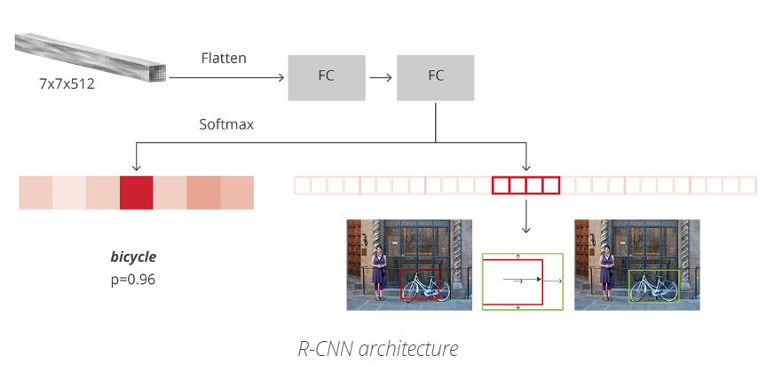
Architecture for Faster RCNN(contd...)
Finally the RCNN uses the information to
1) Classify the content in the bounding box
2) Adjust the bounding box coordinates

Slide 14
Training
Output
Trial Runs
Data Augmentation
Notes:
*sai

Slide 15
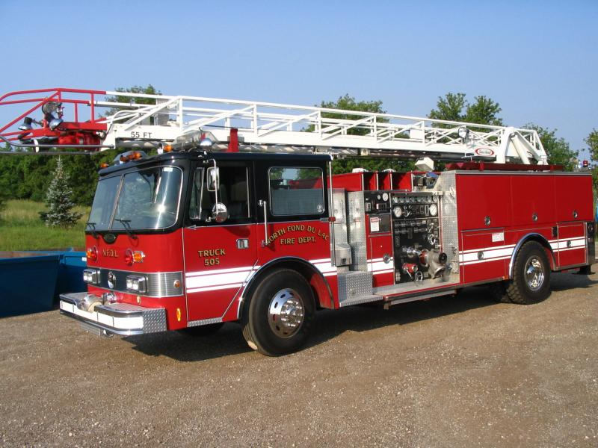
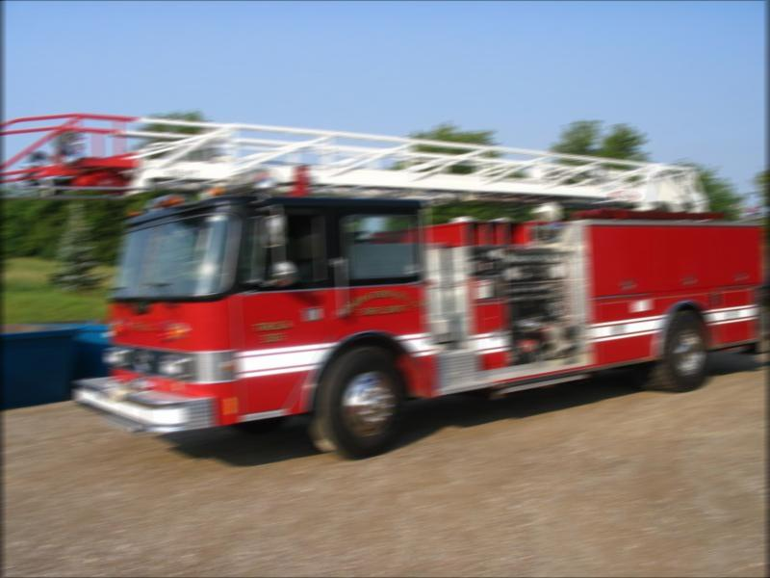
Data Augmentation
Image Database: Imagenet
Total Images: 5256
Notes:
*Dipam

Slide 16
Data Augmentation(contd…)
Mimicking different scenarios to make the model robust
Improving the training efficiency by capturing the most obvious features
Compensation for limited amount of data
Prevent learning of irrelevant patterns
Image Augmentation in MATLAB
Notes:
*Dipam

Slide 17
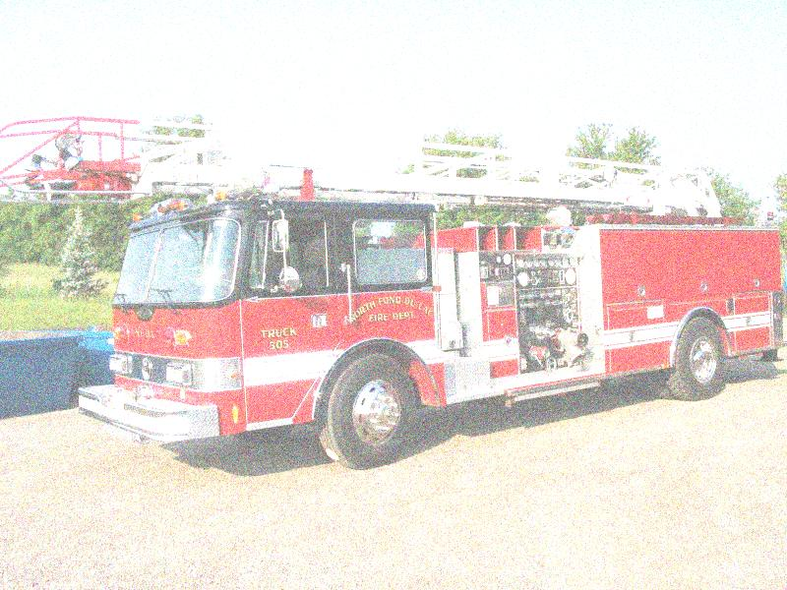
Dataset 1
Original
Gaussian Noise
Notes:
*Dipam

Slide 18

Dataset 1
Gaussian Blur
Motion Blur
Notes:
*Dipam

Slide 19
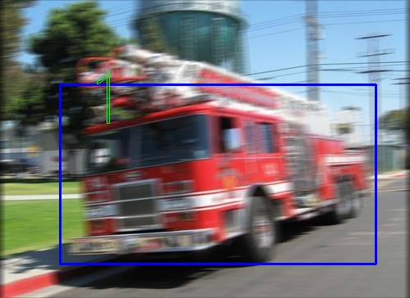
Trial 1
Notes:
Gunjan

Slide 20
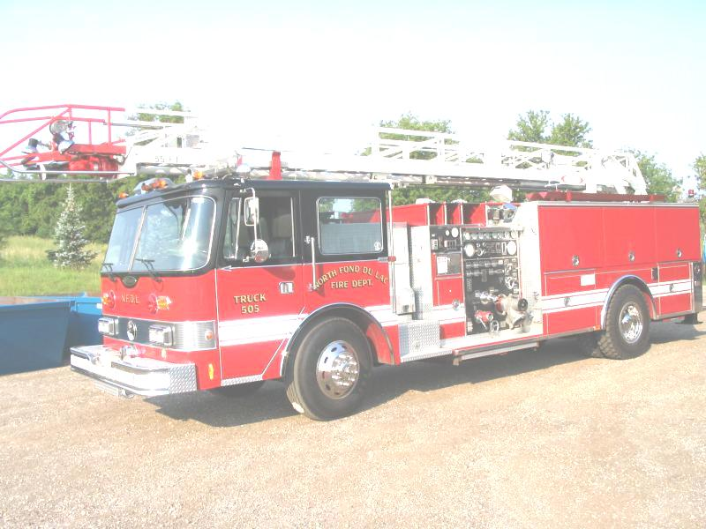
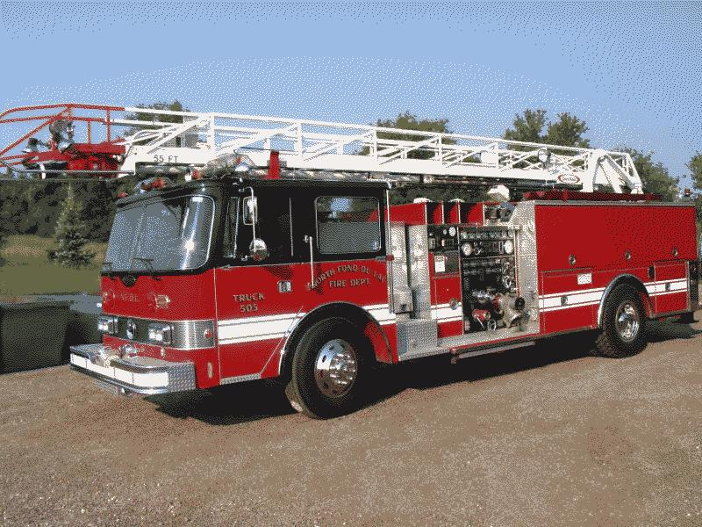
Dataset 2
Bright
Indexed
Notes:
*Dipam

Slide 21
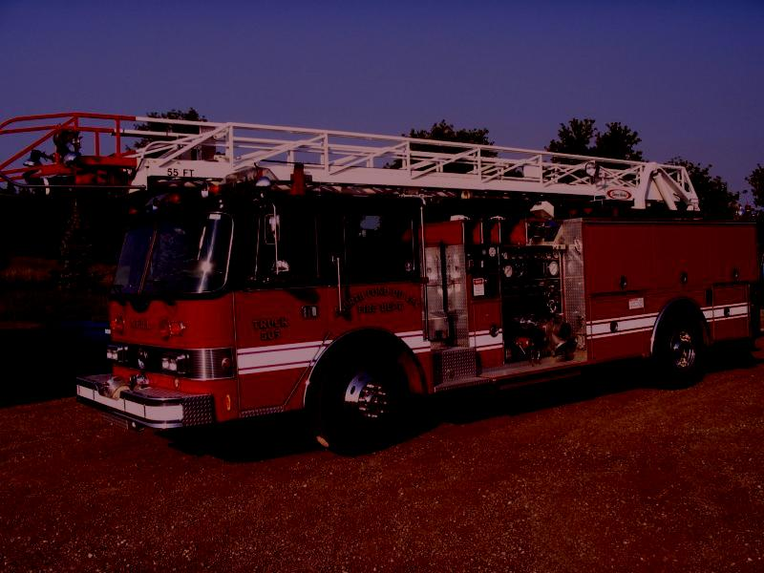
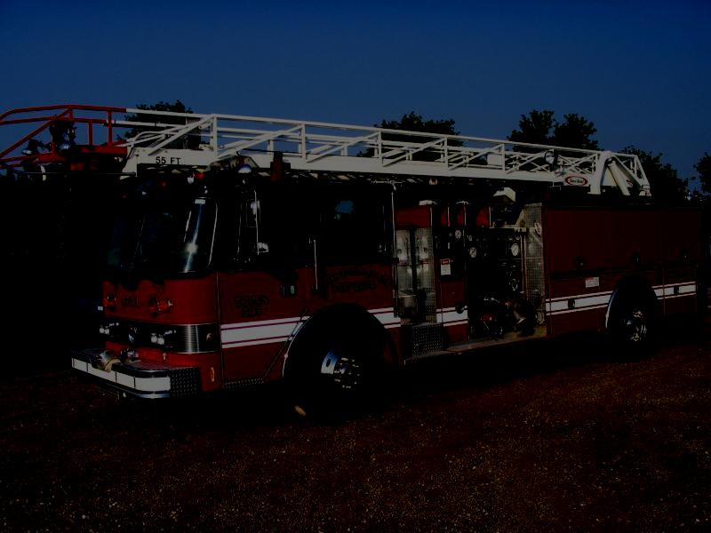
Dataset 2
Sunset
Night
Notes:
*Dipam

Slide 22
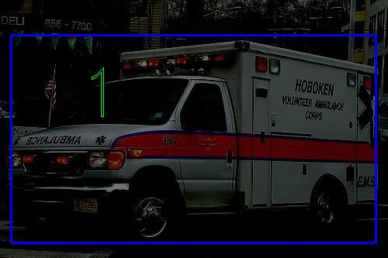
Trial 2

Slide 23
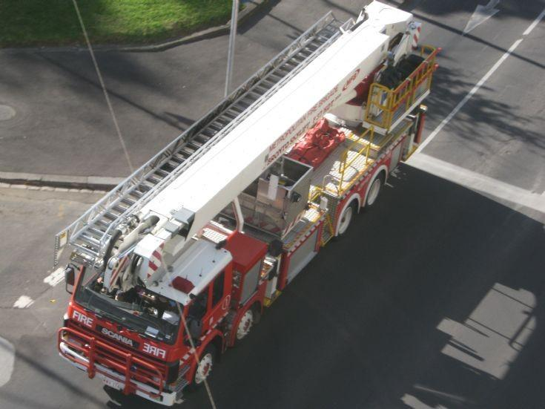
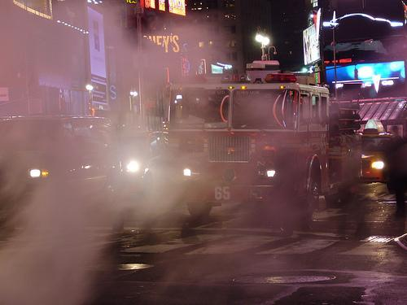
Dataset 3
Top View
Smoky
Notes:
*Gunjan

Slide 24
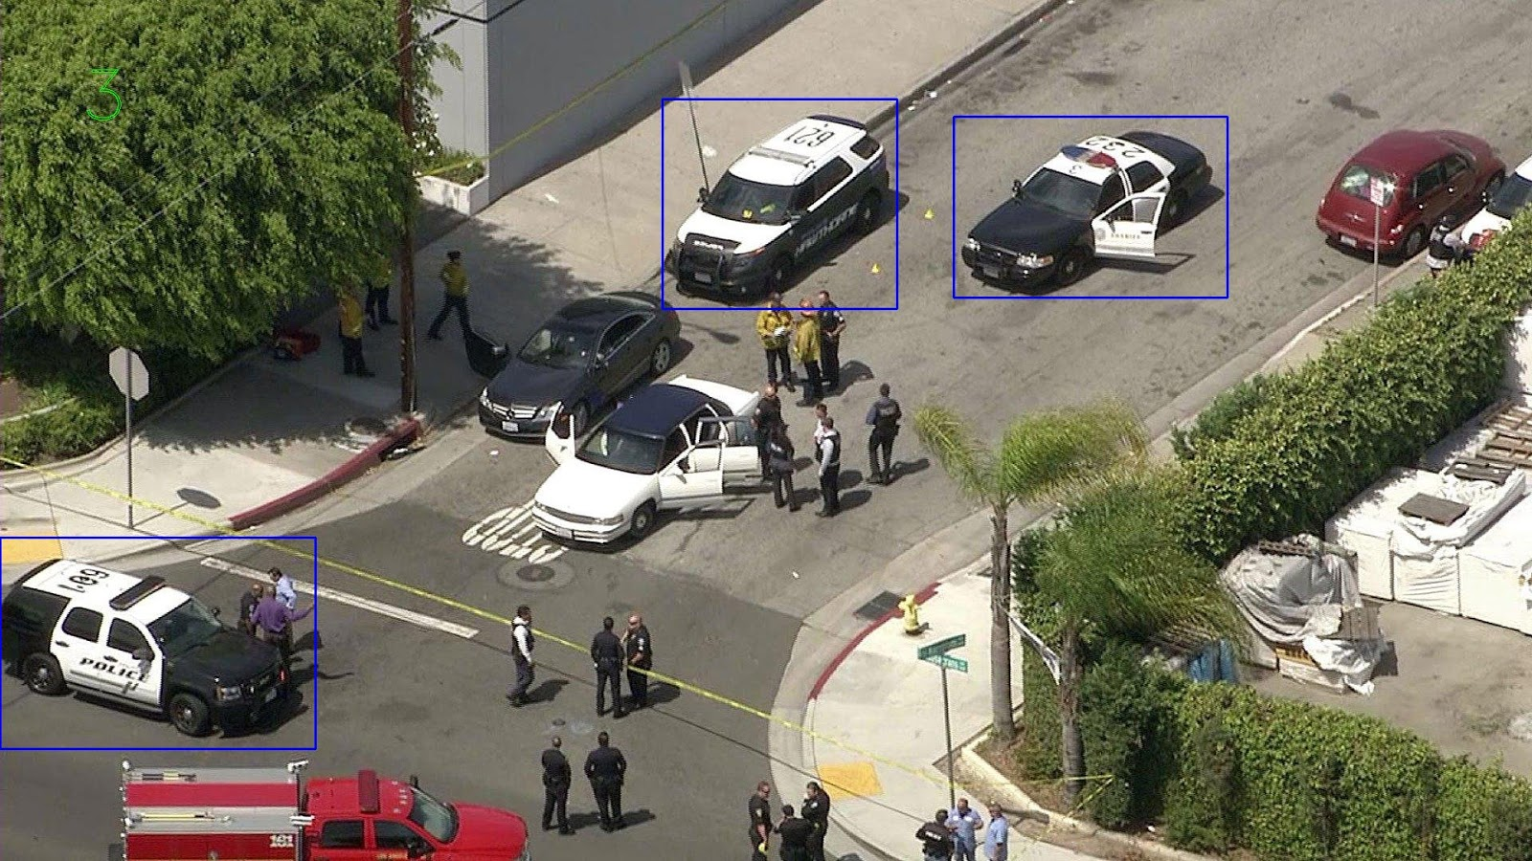
Trial 3
Notes:
Gunjan

Slide 25
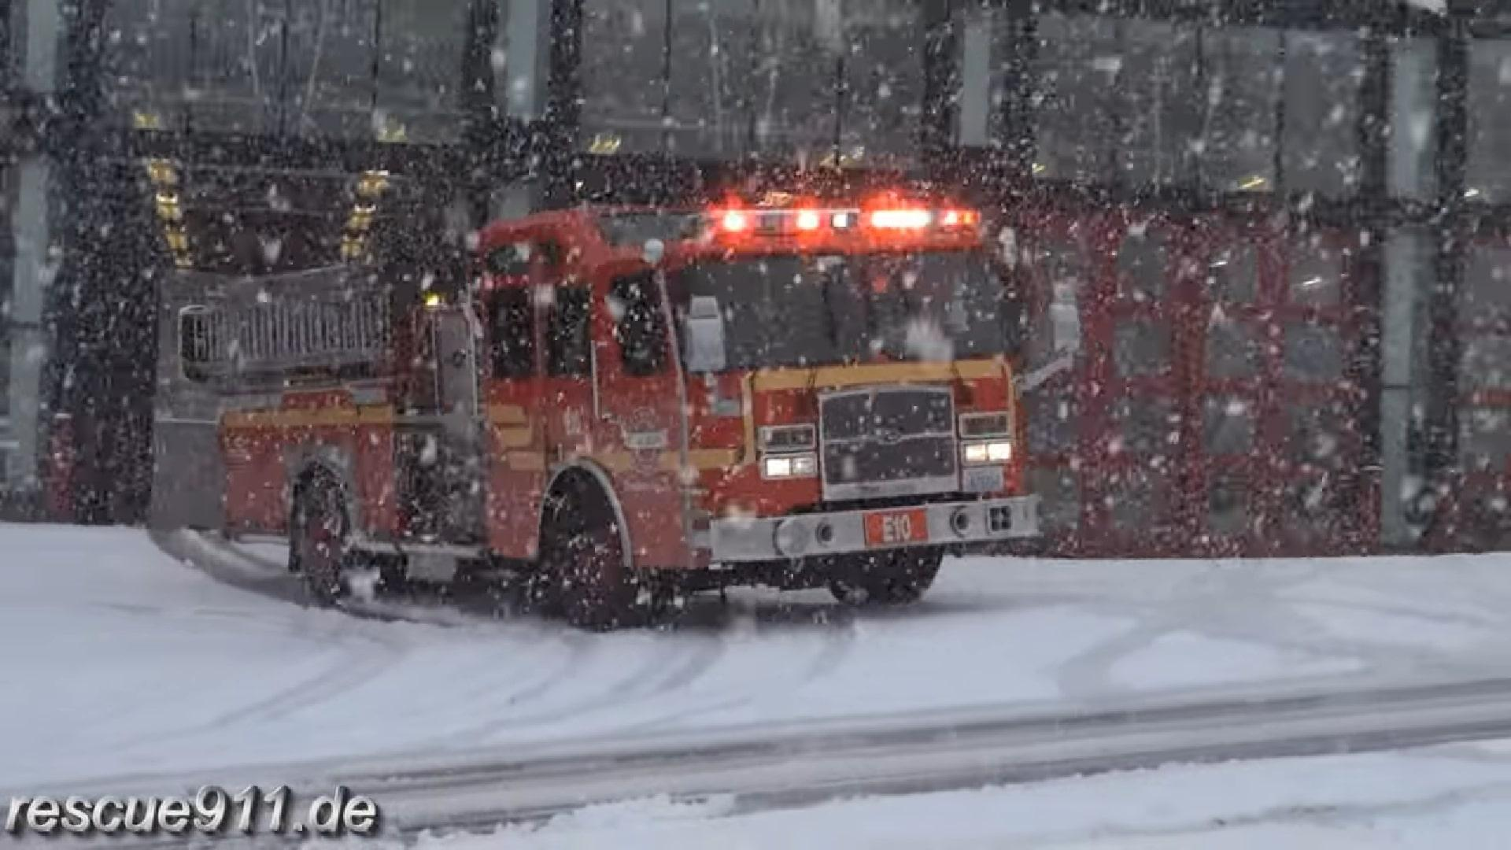
Dataset 4
Snowy
Notes:
*Gunjan

Slide 26
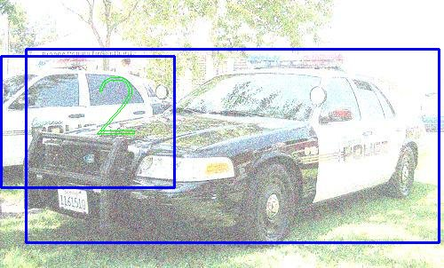
Trial 4
Notes:
Gunjan

Slide 27
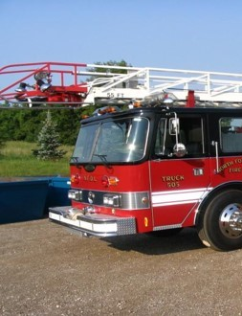
Dataset 5
Cropped
Notes:
*Gunjan

Slide 28
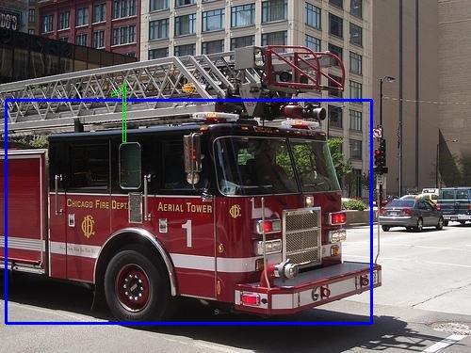
Trial 5
Notes:
Gunjan

Slide 29
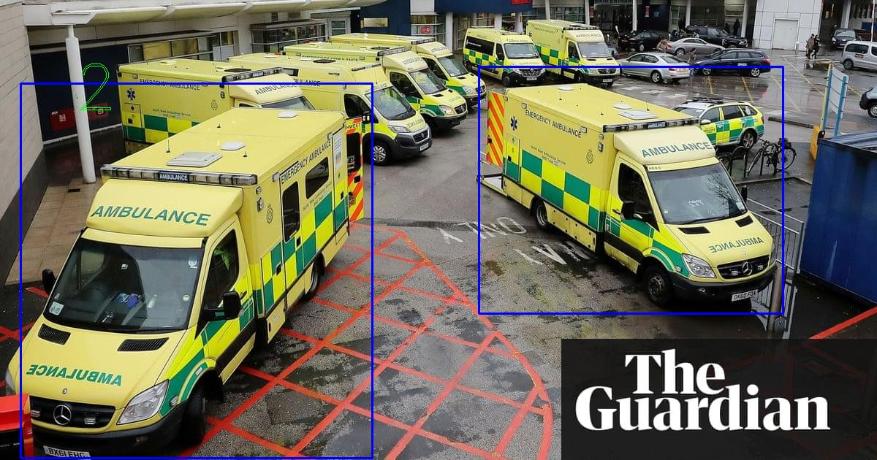
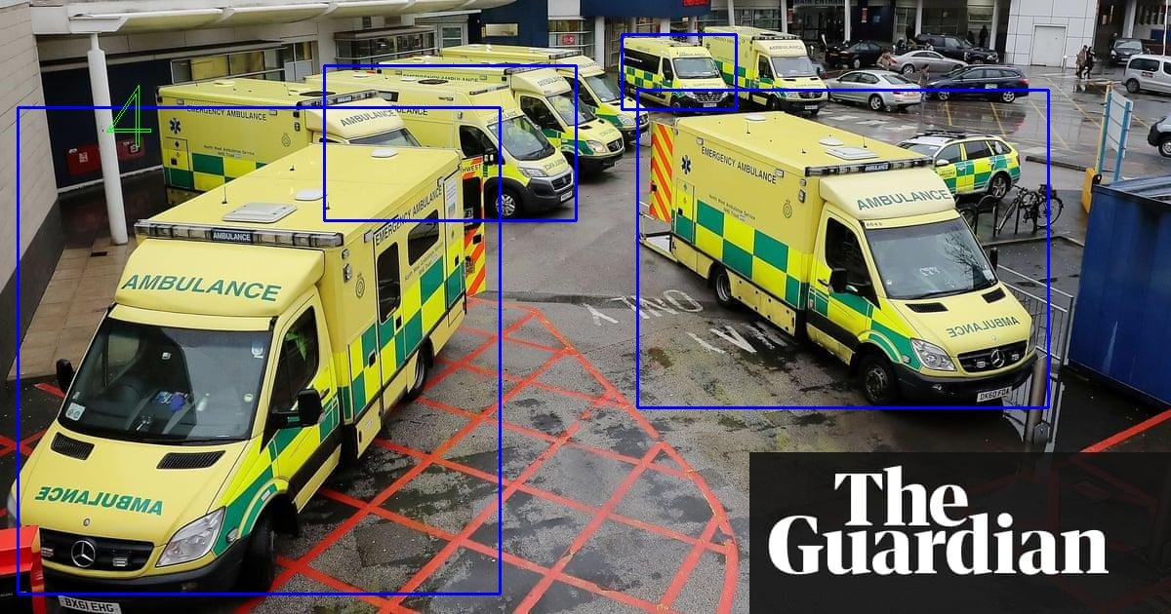

Progress
Notes:
Gunjan

Slide 30
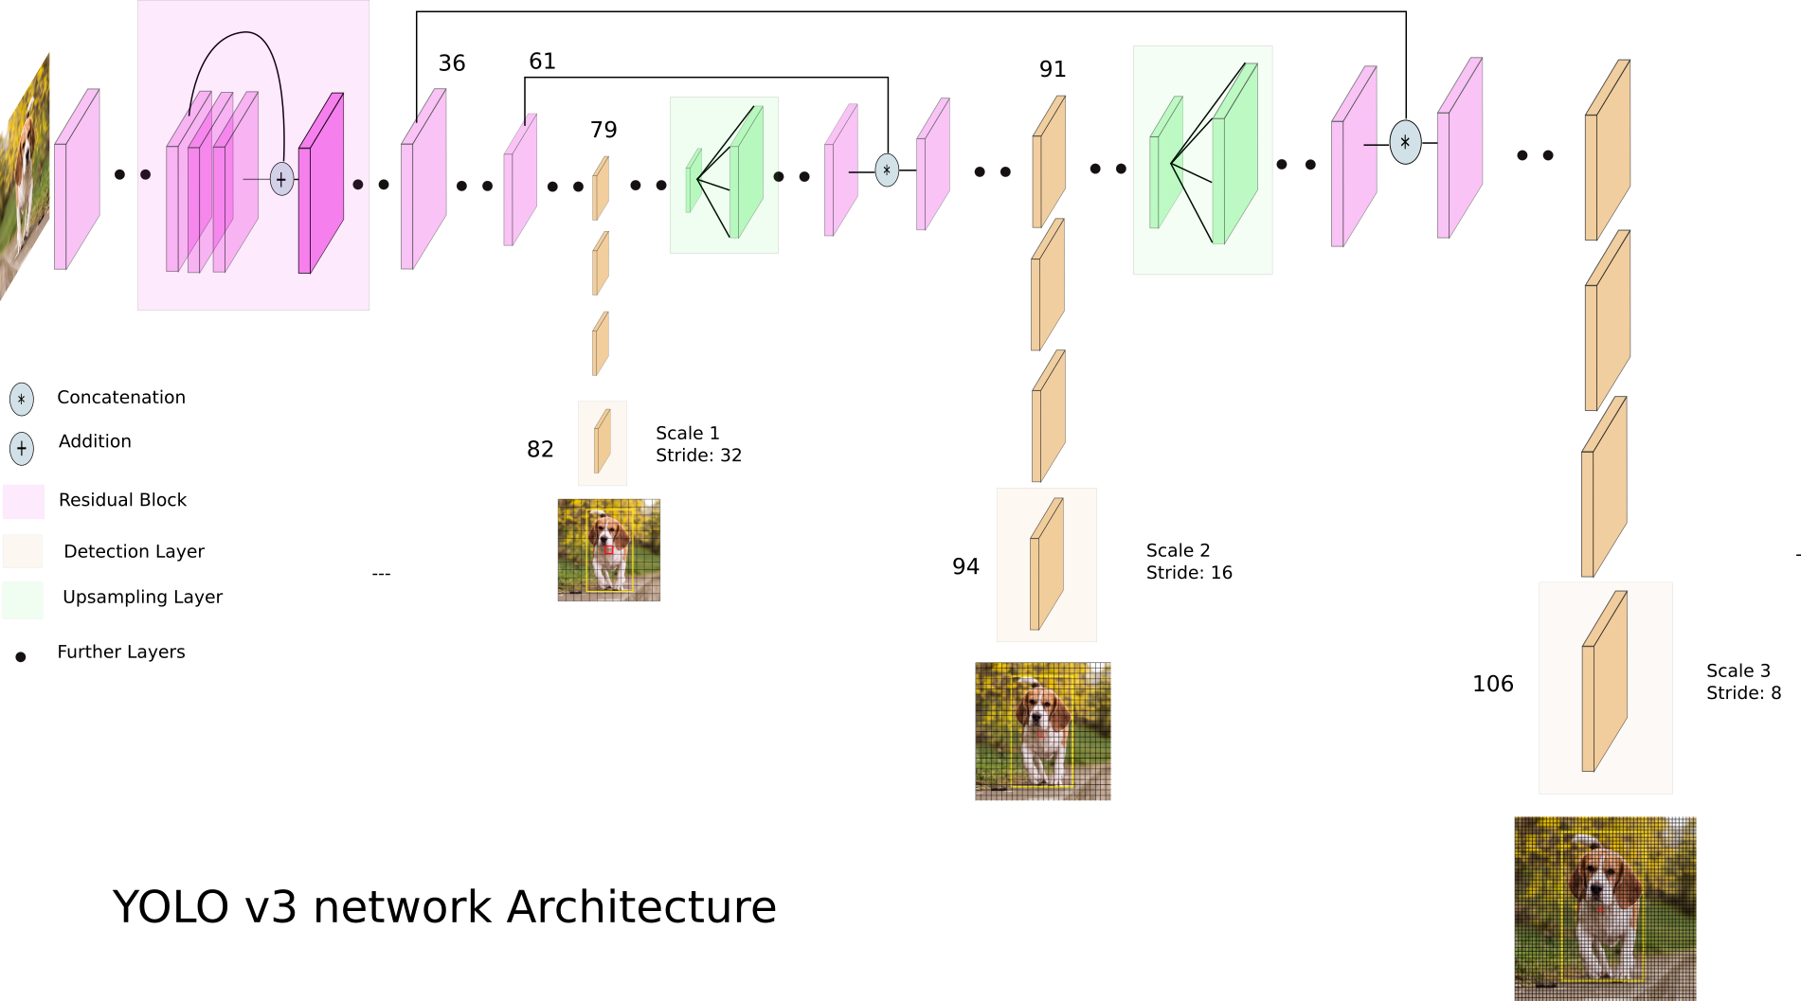
Future Work
Increase the size of dataset
Train on different types of models
https://towardsdatascience.com/yolo-v3-object-detection-53fb7d3bfe6b

Slide 31
References
www.image-net.org
https://medium.com/nanonets/how-to-use-deep-learning-when-you-have-limited-data-part-2-data-augmentation-c26971dc8ced
https://machinelearningmastery.com/transfer-learning-for-deep-learning/
https://zbigatron.com/has-deep-learning-superseded-traditional-computer-vision-techniques/
https://www.cs.swarthmore.edu/~meeden/cs81/f15/papers/Andy.pdf

Slide 32
Questions
Acknowledging: 100.1%

Slide 33
Video comparison RCNN?
Higher accuracy
Some videos for comparison of trained models
https://www.youtube.com/watch?v=Hfy18olOgY8
https://www.youtube.com/watch?v=EY5XbRQylIg
Notes:
*Utsav

